Slide 1
Module 5. Creating and Editing
Modules and Text

Slide 2
MODULE 5. Creating and Editing Modules and Text
What you will learn from this module:
  creating contents using CMS syntax
  reviewing,editing and deleting modules/text of a page
  version management of a module
Notes:
©2005 Microsoft Corporation. All rights reserved.
This presentation is for informational purposes only. Microsoft makes no warranties, express or implied, in this summary.

Slide 3
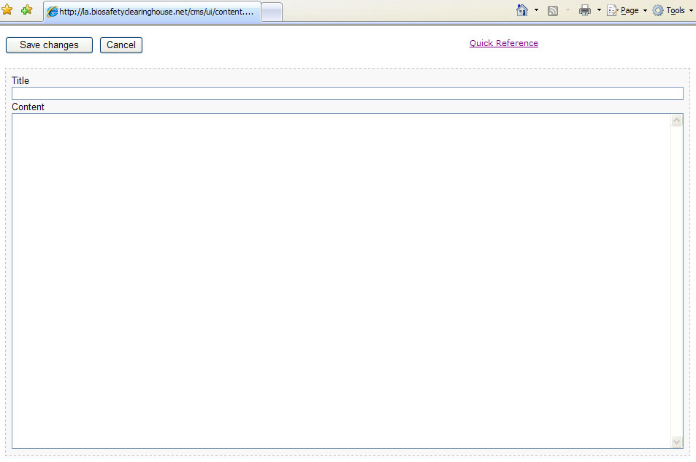

5.1 Content Syntax (wiki syntax)
Hermes provides an easy syntax for creating content.
No knowledge of HTML is required.
The Hermes CMS Quick Reference Page contains all the syntax.
To access this page, click on Quick Reference link from the editor page.
CLICK HERE

Slide 4
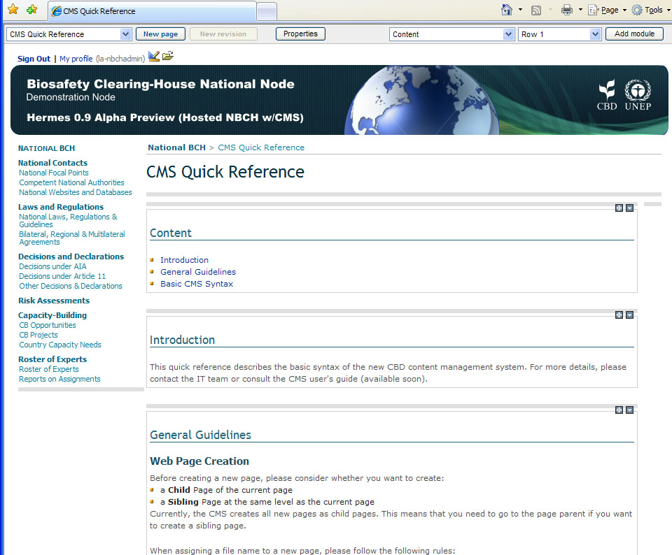
5.1 Content Syntax (wiki syntax)

Slide 5
5.1 Content Syntax (wiki syntax)
For instance the following text:
Hermes is an online **Content Management System** (CMS) based on the //Central Portal of the Biosafety Clearing-House// (BCH). * Item 1 * Item 2

Slide 6
5.1 Content Syntax (wiki syntax)
Would result into:
Hermes is an online Content Management System (CMS) based on the Central Portal of the Biosafety Clearing-House (BCH). Item 1 Item 2

Slide 7
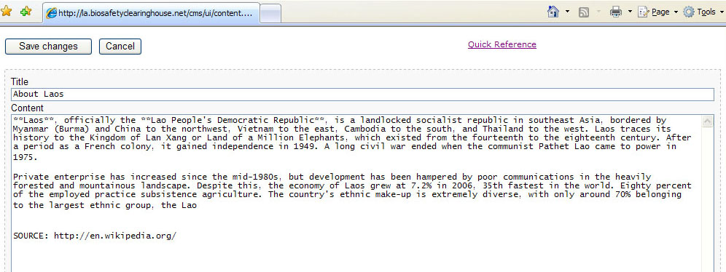
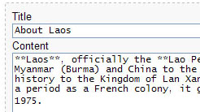
5.1 Content Syntax (wiki syntax)
Example. Adding title and content for the Lao People’s Democratic Republic page.
Step 1. Inside the Edit page, insert text to TITLE and CONTENT for the page.
ADD TEXT
HERE

Slide 8


5.1 Content Syntax (wiki syntax)
Step 2. Click on the Save changes button.
CLICK HERE
Observe that some Content syntax were used to apply text formatting, such as bold.

Slide 9
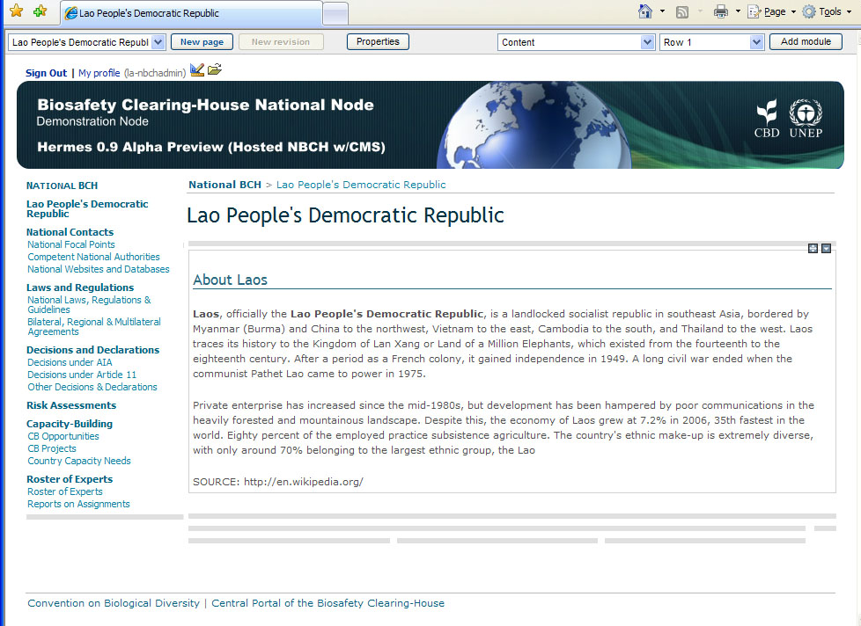
5.1 Content Syntax (wiki syntax)
After this action, the administrator will be directed to the Lao People’s Democratic Republic page where the new content can be viewed.

Slide 10
5.2 Reviewing/Editing Modules
Use the content module menu to review/edit the content of the module.
Can be accessed using the icon visible at the top-right corner of each module.

Slide 11
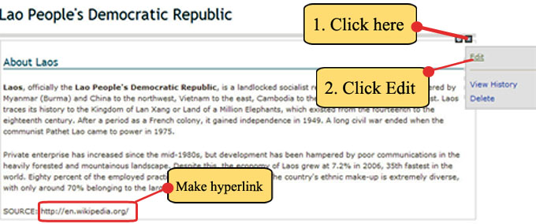
5.2 Reviewing/Editing Modules
Example. Editing information to the Lao People’s Democratic Republic page. Following the previous example, we will edit a portion of the content. The last line containing http://en.wikipedia.org/ will be transformed to a hyperlink.
Step 1. Click the icon then click Edit

Slide 12
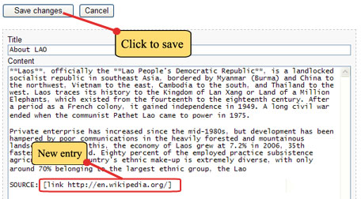
5.2 Reviewing/Editing Modules
Step 2. The Content Editor page will now appear. Edit the last line to:
SOURCE: [link http://en.wikipedia.org/ ]
Step 3. Click on the SAVE CHANGES button.

Slide 13
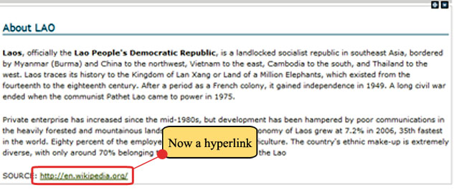
5.2 Reviewing/Editing Modules
After saving, the administrator will exit the Content Editor for the About LAO page.
The last line is now a hyperlink value.
Observe the color changes to blue and when clicked, a line appears on it.

Slide 14
5.3 Version Management of Modules
To view editing history of a page, click on the View History inside the Content module menu.
This facility can be used to track changes done by users with editing rights to the page.

Slide 15
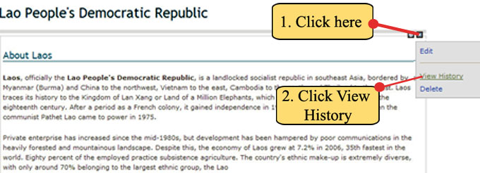
5.3 Version Management of Modules
Example. To view the Editing History information of the Lao People’s Democratic Republic page.
Step 1. Click the icon then click View History.

Slide 16
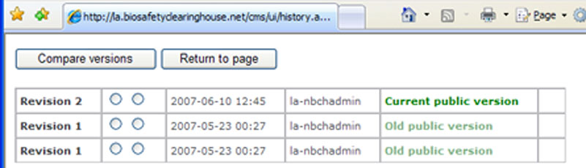
5.3 Version Management of Modules
The Revision list page will appear.
Compare versions button
Will be directed to page showing comparison between two revisions.
Shown are the following items.

Slide 17
5.3 Version Management of Modules
The Revision list page will appear.
Return to
page button
Will return to original page.

Slide 18
5.3 Version Management of Modules
The Revision list page will appear.
Revision &
Number
Shows the number of revisions for the page.

Slide 19
5.3 Version Management of Modules
The Revision list page will appear.
User name
Name of the user who did the revision to the page

Slide 20
5.3 Version Management of Modules
The Revision list page will appear.
Public Versions
Shows if the revision is the current or the old public version.

Slide 21
5.3 Version Management of Modules
The Revision list page will appear.
Radio buttons
Used to select revision numbers to be compared.

Slide 22
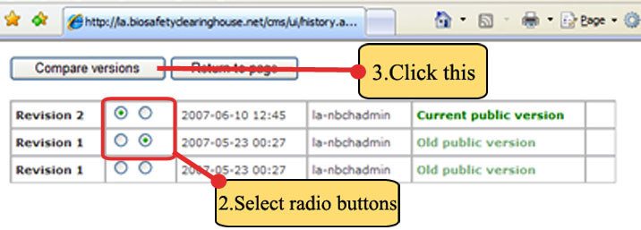
5.3 Version Management of Modules
Step 2. Compare Revisions 1 and 2. Click on the radio buttons of the two revisions.
Step 3. Click the Compare versions button, as shown.

Slide 23
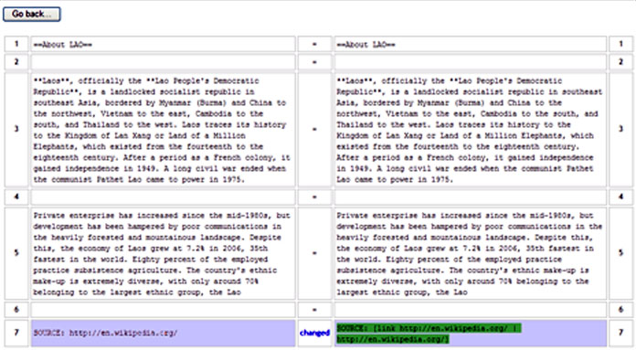
5.3 Version Management of Modules
The comparison page will now appear on screen.
See the changes made on the last line as shown.

Slide 24
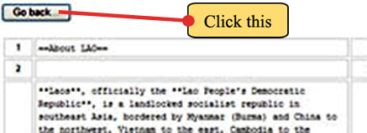
5.3 Version Management of Modules
Step 4. Click on the Go Back button, to exit this page after examining the comparison.

Slide 25
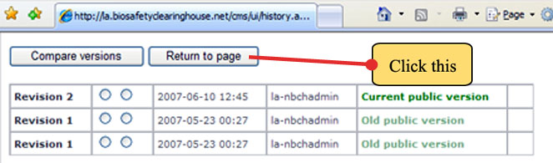
5.3 Version Management of Modules
Step 5. The Revision list page will reappear. Lastly, click on the Return Page to return to the main page.

